Slide 1

Kenya Tweet Classifier: Detecting Real-time Hate Speech and Misinformation
By: Foresight Analytica

Slide 2
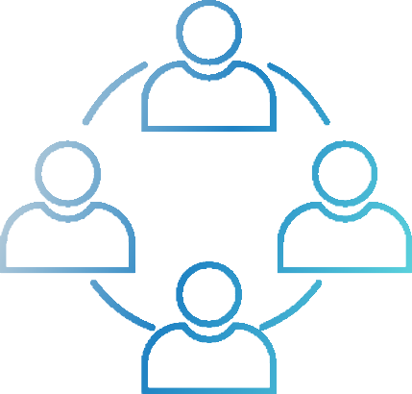
OUR TEAM
Morgan Abukuse
Dennis Mwania
Linet Patriciah
Precious Kalia
Felista Kiptoo

Slide 3
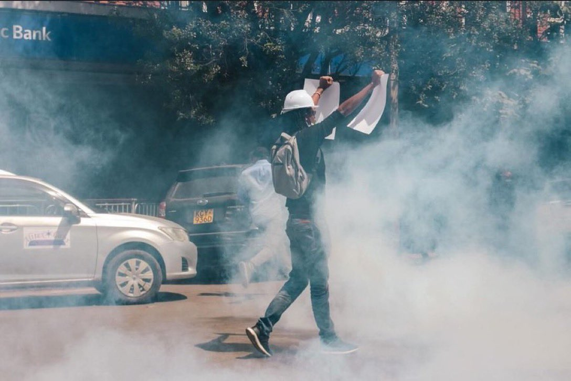
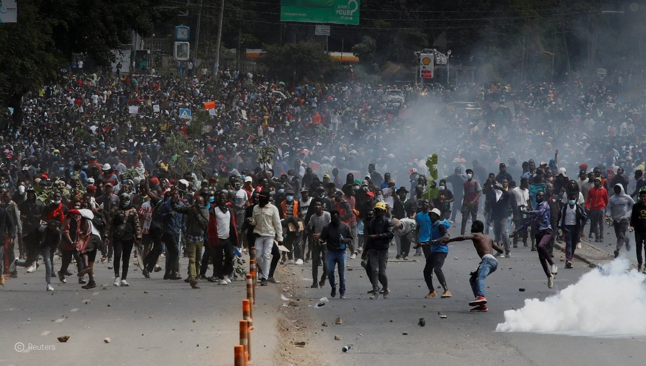
Introduction
Social media platforms like Twitter have become both tools for civic engagement and hotbeds for hate speech and misinformation. Kenya has experienced an alarming rise in online hate speech and misinformation, particularly on platforms like Twitter. Our presentation introduces a locally trained, real-time NLP classifier built to flag such toxic content before it spreads—offering a data-driven, peace-first approach to safeguarding national unity and ensuring truth prevails in Kenya’s digital public square.

Slide 4
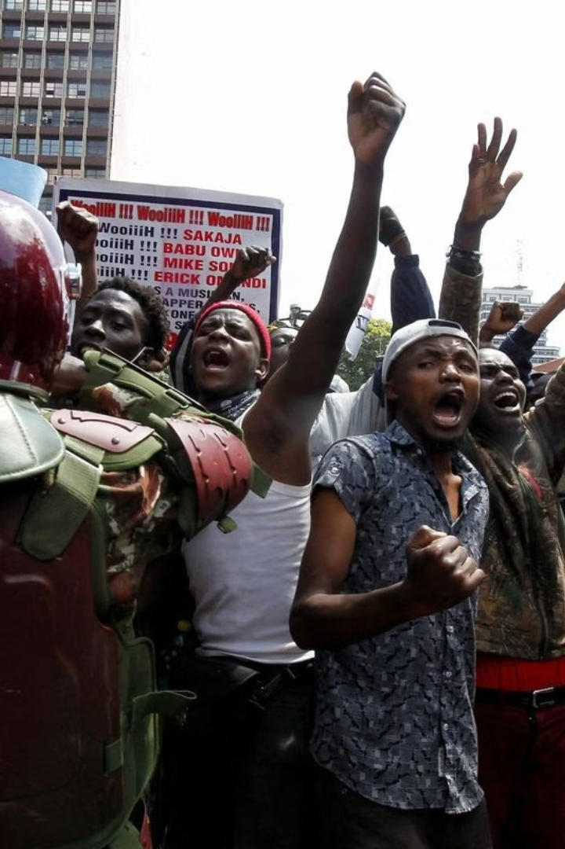
PROBLEM STATEMENT
In Kenya, digital platforms like Twitter—once tools for civic expression—have become breeding grounds for hate speech and misinformation, as seen during the 2022 elections and the 2024 Finance Bill protests, where viral posts fueled unrest. According to KHRC & KNCHR ,Over 65 deaths and 230 injuries recorded during the #RejectFinanceBill2024 protests 283+ arrests, dozens of disappearances by Human rights commissions Viral tweets and videos mobilized crowds, spread fake news, and incited fear by NCIC & fact-checkers. In 2022, IEBC flagged coordinated online misinformation during elections.

Slide 5
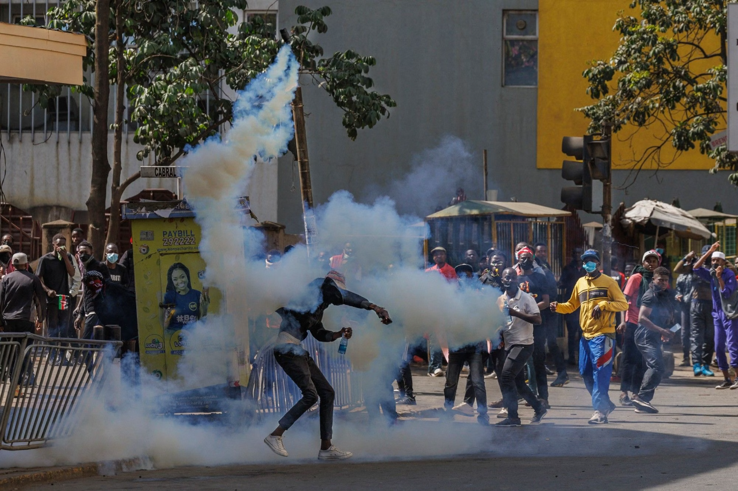
PROJECT OBJECTIVES
To detect hate speech in tweets using Natural Language Processing (NLP)
To flag misinformation by matching tweets with verified claims from PesaCheck and AfricaCheck
To provide a real-time dashboard for tweet input, analysis, and classification
To empower key institutions (NCIC, CAK, IEBC, DCI, media) to respond proactively To support peace, truth, and civic engagement in Kenya’s online spaces

Slide 6

Key Stakeholders
National Cohesion and Integration Commission (NCIC)
Independent Electoral and Boundaries Commission (IEBC)
Media houses and journalists
NGOs and civil society
General public

Slide 7

Metrics of Success
F1-Score :Achieving an F1-Score of 80% or higher for hate speech classification.
Accuracy : Aiming for overall accuracy of 85% and above in classifying tweets correctly.
Precision :Maintaining at least 80% precision ensures most flagged tweets are truly
hate speech or misinformation.
Usability : Ensure it is user-friendly and operates smoothly for both technical
and non-technical users.
Scalability: The system should be able to handle increased tweet volumes and
allow batch uploads

Slide 8
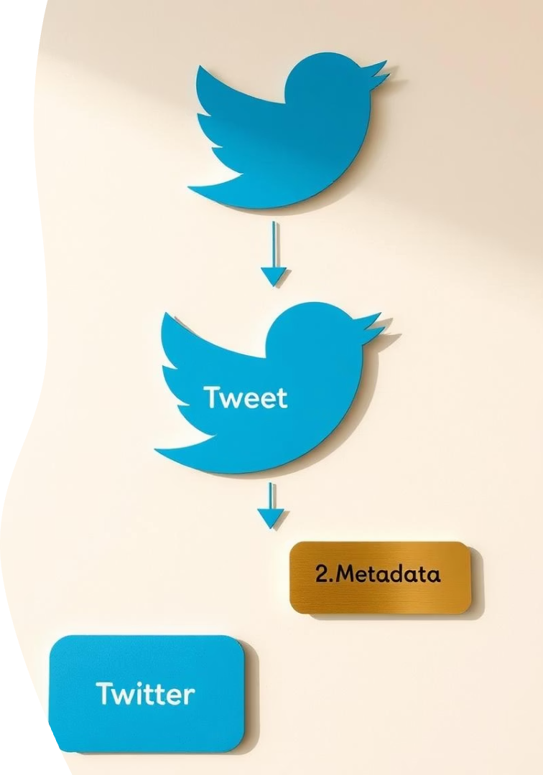
Data Overview
We used real Twitter data collected from Kaggle
We scrapped claims from PesaCheck and Africa Check
Source
10,000 rows
Size
11,723 tweets
Features
Tweet text, metadata, user behavior
Labels
Hate speech, safe content, verified misinformation
Verification
Cross-checked with fact-checking databases

Slide 9
Feature Engineering
Step | What it does
Text Cleaning | Lowercased, removed punctuations, URLs, stopwords.
TF-IDF Vectorization | Converted text into numeric word importance scores.
n-Grams(1,2) | Captured both individual words and phrases(e.g. ‘raila Odinga', 'kill all’).
Feature Limit(18,000) | Managed dimensionality to improve speed and accuracy.
(Optional) | Consider tweet length exclamations or keywords.

Slide 10
MODELING
Model | Accuracy | Precision | Recall | F1 Score
Random Forest | 0.8376 | 0.3264 | 0.1298 | 0.1858
Naïve Bayes | 0.8656 | 0.7442 | 0.0884 | 0.1580
XGBoost | 0.8676 | 0.8421 | 0.0884 | 0.1600
Logistic Regression | 0.6780 | 0.1922 | 0.3923 | 0.2579
SVM | 0.6874 | 0.1952 | 0.3812 | 0.2582

Slide 11
Key Insights
Accuracy:
XGBoost (86.76%) and Naive Bayes (86.56%)
Precision:
XGBoost leads with 84.21% — good at avoiding false alarms
Best Overall Score:
Random Forest had the best F1-score (18.58%) and AUC (0.59), but lower precision

Slide 12
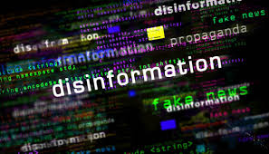
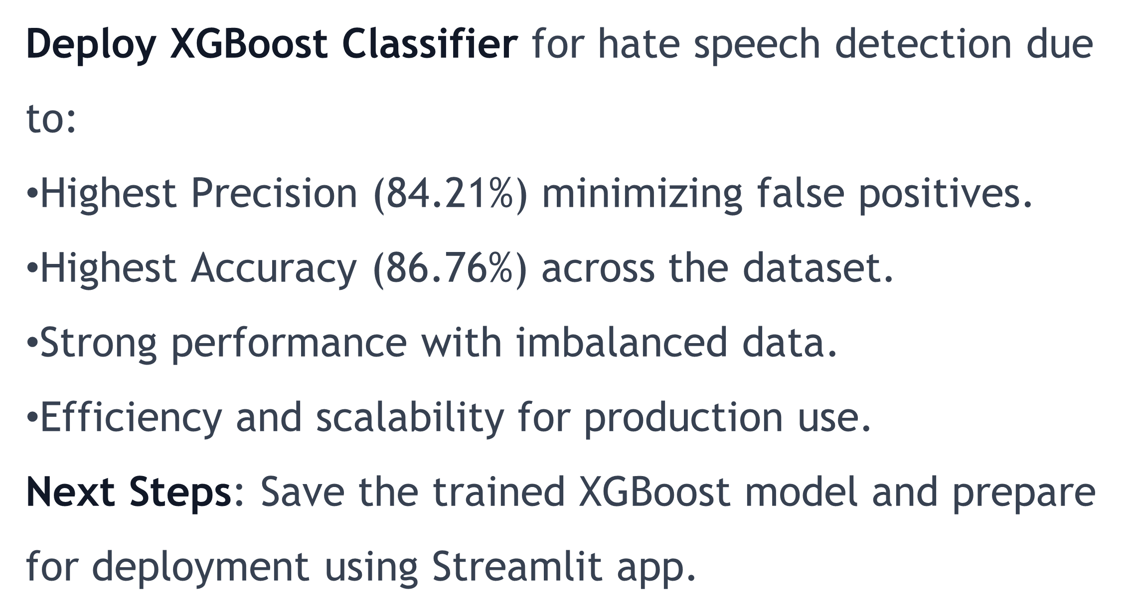
SOLUTION

Slide 13
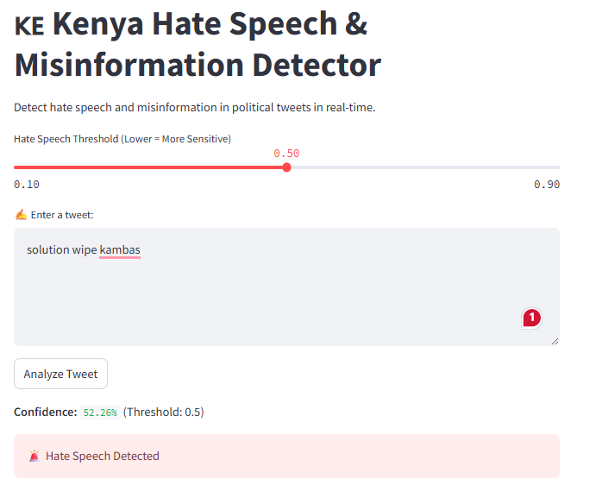
Demo and App Interface
We made this app easy to use. It shows how we can find hate words and misinformation in Kenya tweets.

Slide 14
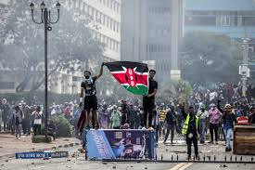
Real-World Use Cases
To help track hate speech spikes especially
during electoral periods.
By providing alerts to prevent escalation of conflicts.
Enhancing efforts to promote social harmony online.
Helping the media track and respond to toxic
online trends.

Slide 15

Impact
Prevention
Promotion
Empowerment
Prevents harmful online content from triggering real violence.
Encourages respectful digital discourse
This helps in giving institutions in charge actionable insights

Slide 16
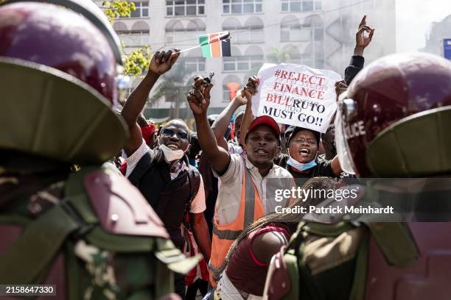
Our Next Steps
Introduce Deep Learning Models
Expand and Diversify the Labeled Dataset
Scrape Fact-Checked Claims Automatically

Slide 17

Lessons Learned
Clean Data = Better Results: Cleaning tweets made a big difference in
performance.
Not All Models Work the Same: We had to test many to find the best
performer.
Deployment Knowledge
careful thought and teamwork.
Natural Language Processing (NLP): Learned how to preprocess, tokenize, and vectorize text data (e.g., using NLTK, TF-IDF Vectorizer, or word embeddings)
Balancing Precision and Recall Is Challenging
Data Quality and Labeling Matter More Than Algorithms
Building a Tool People Can Use Is the Real Win

Slide 18

Thank you!
Do you have any questions?

